Slide 1
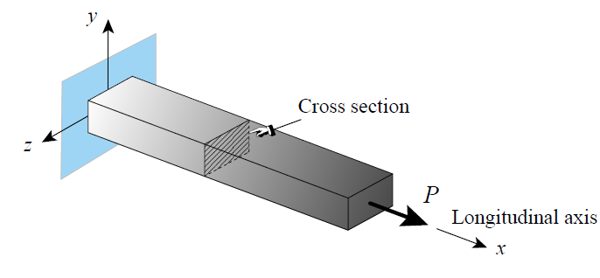
2.4 Variational Formulations
For details of the variational concepts (refer Theory of elasticity in Geotechnical Engineering)
For illustration, we use the bar element as shown below

Slide 2
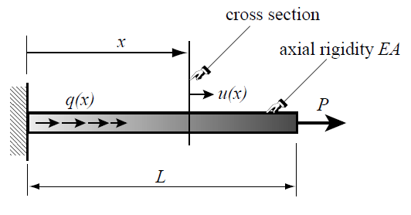
2.4 Variational Formulations

Slide 3
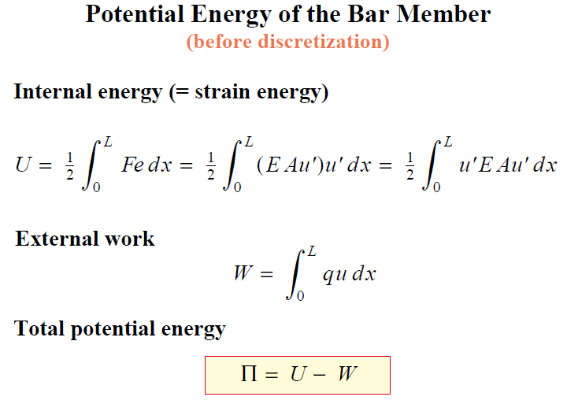
2.4 Variational Formulations

Slide 4
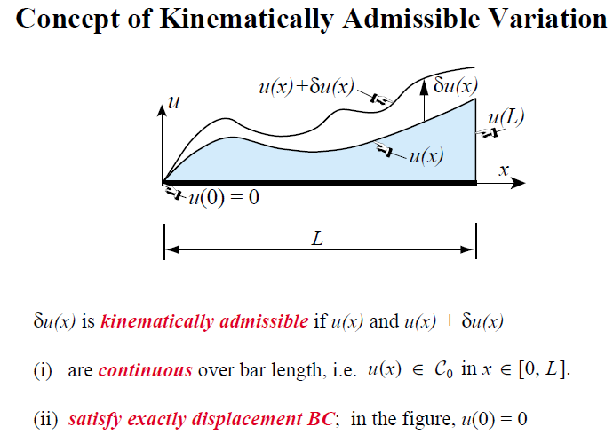
2.4 Variational Formulations

Slide 5
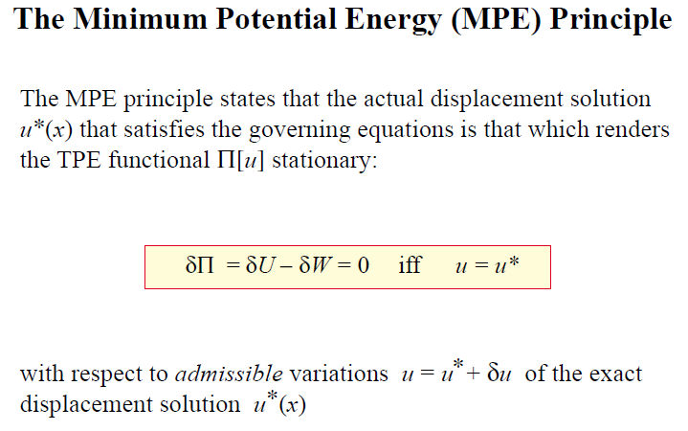
2.4 Variational Formulations

Slide 6
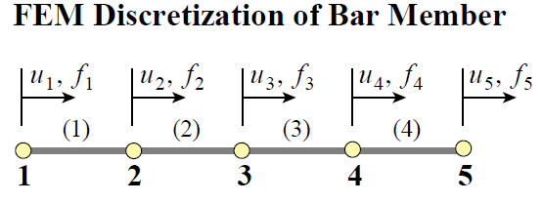

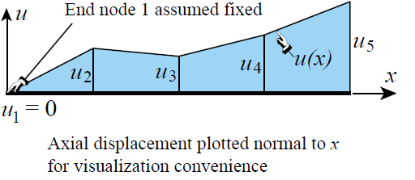
2.4 Variational Formulations

Slide 7
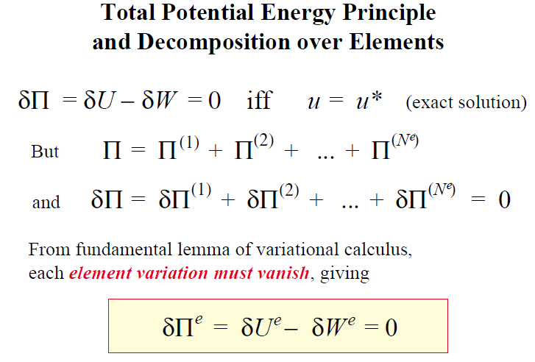
2.4 Variational Formulations

Slide 8
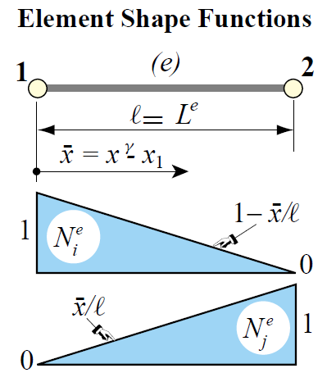
2.4 Variational Formulations

Slide 9
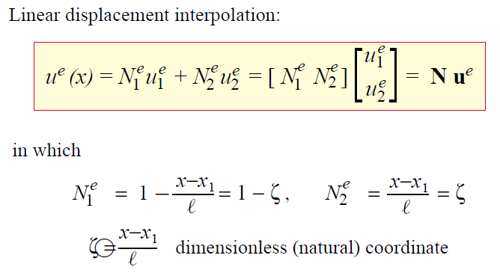
2.4 Variational Formulations

Slide 10
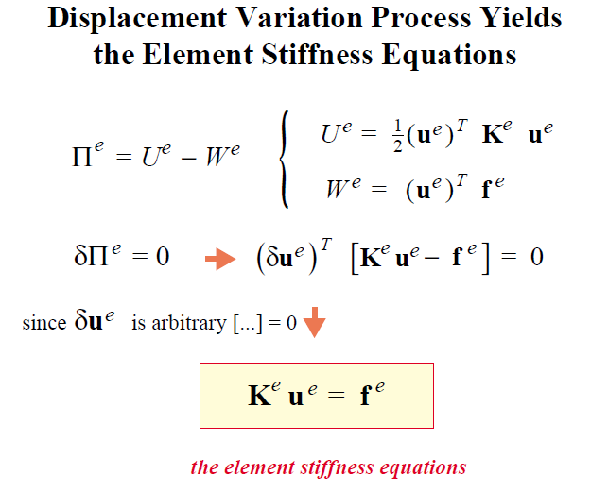
2.4 Variational Formulations

Slide 11
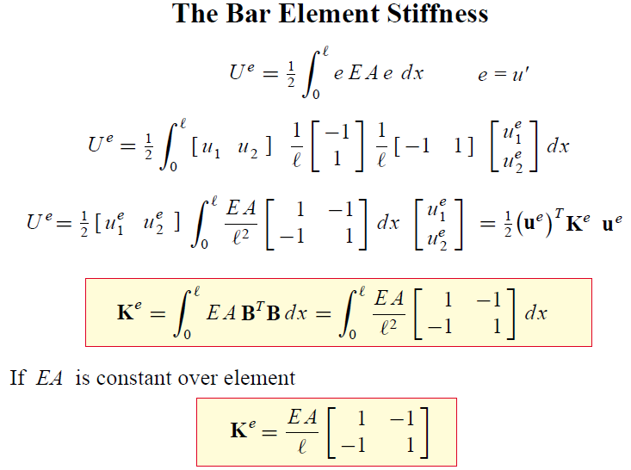
2.4 Variational Formulations

Slide 12
2.5 FE Modeling
2.5.1 Introduction:
Finite element numerical methods are based on the concept of subdividing a continuum into small pieces.
They describe the behavior or actions of the individual pieces and then reconnecting all the pieces to represent the behavior of the continuum as a whole.
This process of subdividing the continuum into smaller pieces is known as discretization or meshing.
The pieces are called finite elements

Slide 13
2.5 FE Modeling...
2.5.2 Meshing:
Discretization or meshing is one of the three fundamental aspects of FE modeling.
The other two are defining material properties and boundary conditions.
Diescretization involves defining geometr, distance, area, and volume.
It is the component that deals with the physical dimensions of the domain.

Slide 14
2.5 FE Modeling...
General FEM Modeling Rules:
Use the simplest elements that will do the job
Never, never, never use complicated or special elements unless you are absolutely sure of what you are doing
Use the coarsest mesh that will capture the dominant behavior of the physical model, particularly in design situations
3 word summary: Keep It Simple!

Slide 15
2.5 FE Modeling...
Mesh Refinement:
Use a relatively fine (coarse) discretization in regions where you expect a high (low) gradient of strains and/or stresses.
Regions to watch out for high gradients are:
Near entrant corners, or sharply curved edges.
In the vicinity of concentrated (point) loads, concentrated reactions, cracks and cutouts.
In the interior of structures with abrupt changes in thickness, material properties or cross sectional areas.

Slide 16
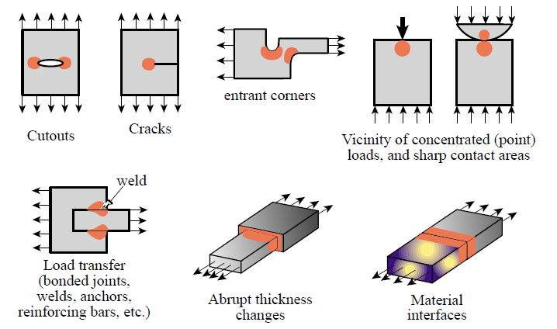
2.5 FE Modeling...
Where Finer Meshes Should be Used:

Slide 17
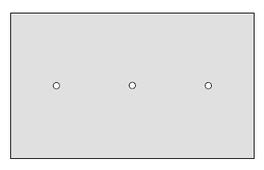
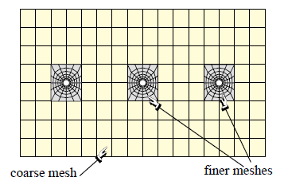
2.5 FE Modeling...
Where Finer Meshes Should be Used:

Slide 18
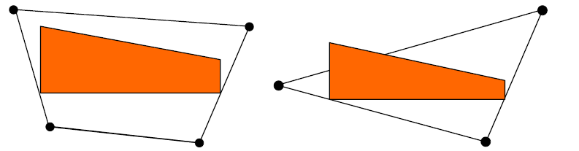
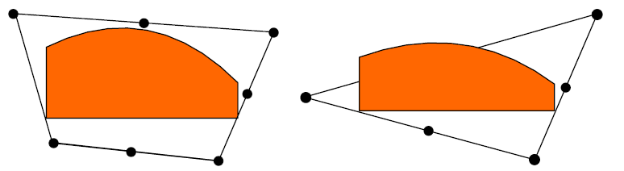
2.5 FE Modeling...
Field Variable Distribution
In FE formulation, it is necessary to adopt a model describing the distribution of the primary variable within the element.
This could be linear or curved

Slide 19
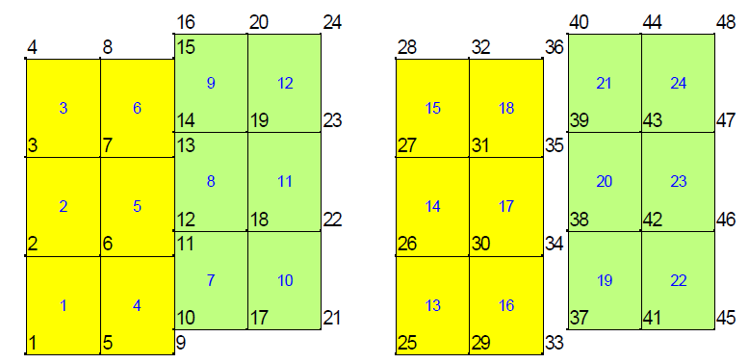
2.5 FE Modeling...
Element and mesh compatibility
Elements must have common nodes in order to be considered connected, and the distibution of the primary unnown along an element edge must be the same for an edge common to two elements.

Slide 20
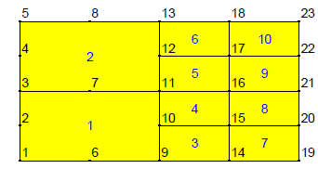
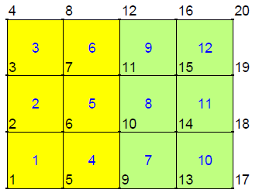
2.5 FE Modeling...
Mesh compatibility

Slide 21
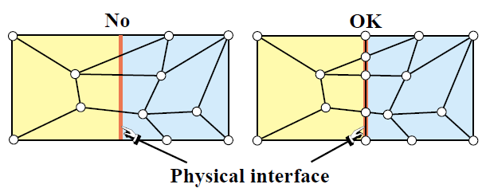
2.5 FE Modeling...
Elements Must Not Cross Interfaces

Slide 22
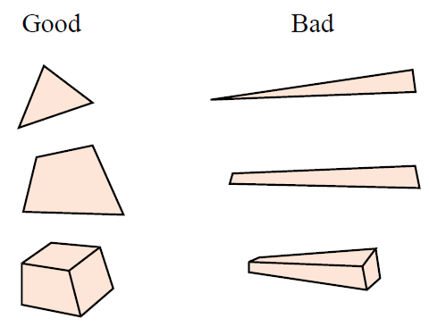
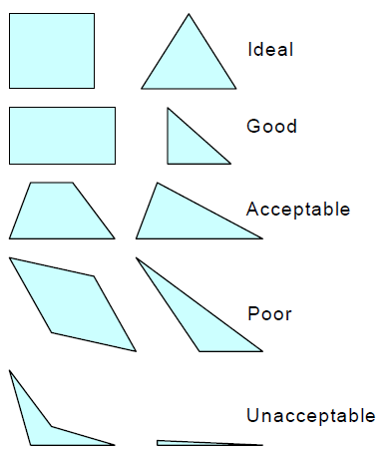
2.5 FE Modeling...
Element Aspect Ratio (2D/3D):
Elongated or “skinny” elements
How small or large should this be??

Slide 23
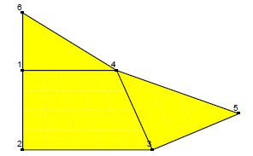
2.5 FE Modeling...
Element Geometry Preferences:
Other things being equal, prefer
2D: Quadrilaterals over Triangles
3D: Bricks over Wedges
Wedges over Tetrahedra

Slide 24
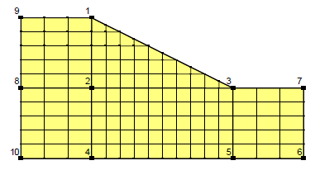
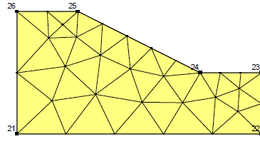
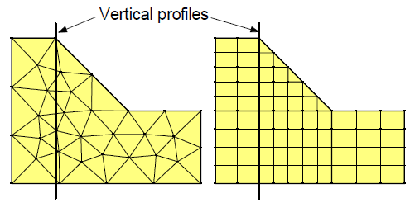
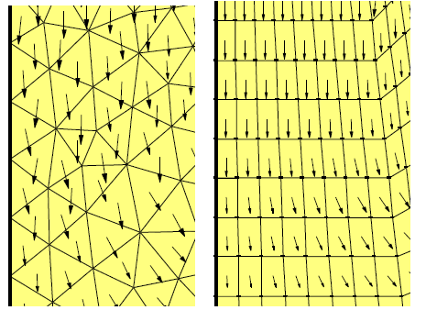
2.5 FE Modeling...
Creating Mesh:
Automatic/ manual
Structured/unstructured
Interface

Slide 25
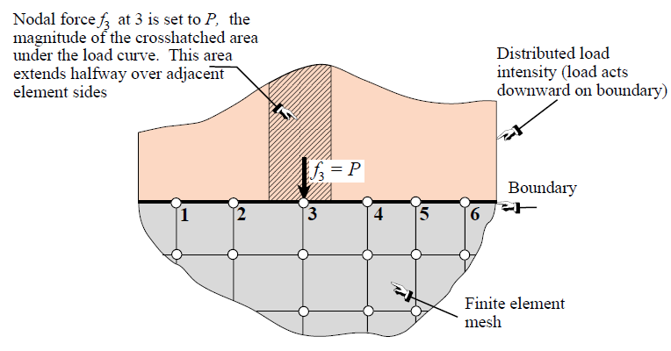
2.5 FE Modeling...
Direct Lumping of Distributed Loads
Distributed surface traction
Volume loads
Consistent load
Node by Node (NbN) Distributed Load Lumping

Slide 26
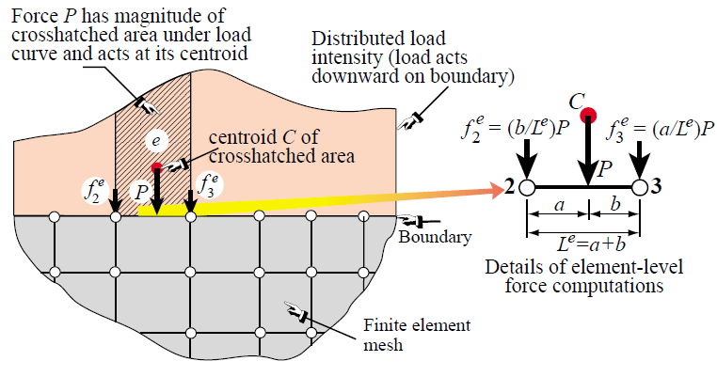
2.5 FE Modeling...
Element by Element (EbE) Distributed Load Lumping

Slide 27
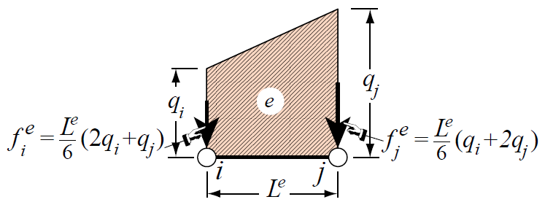
2.5 FE Modeling...
EbE Shortcut for Linearly Varying Line Load
(Bypasses Centroid Calculation)

Slide 28
2.5 FE Modeling...
Boundary Conditions (BCs)
The most difficult topic for FEM program users
Two types
Essential
Natural
If a BC involves one or more DOF in a direct way, it is essential and goes to the Left Hand Side (LHS) of Ku = f
Otherwise it is natural and goes to the Right Hand Side (RHS) of Ku = f

Slide 29
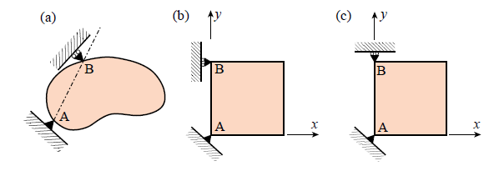
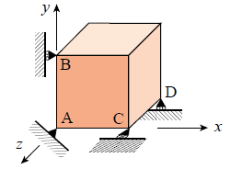
2.5 FE Modeling...
Support Conditions

Slide 30
2.5 FE Modeling...
Symmetry and antisymmetry conditions
Engineers doing finite element analysis should be on the lookout for conditions of symmetry or antisymmetry.
Judicious use of these conditions allows only a portion of the problem to be analyzed, with a consequent saving in data preparation and computer processing time.
A symmetry line in two-dimensional motion can be recognized by remembering the “mirror” displacement pattern.
An antisymmetry line can be recognized by the displacement pattern.

Slide 31
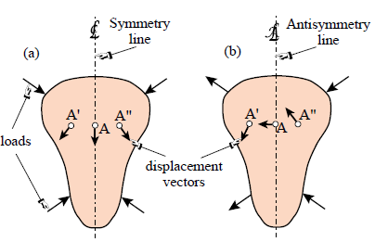
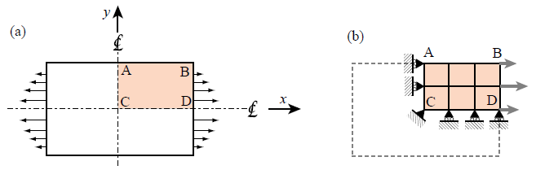
2.5 FE Modeling...

